Slide 1
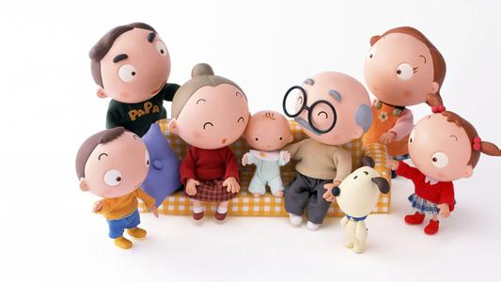
My Family
Period2:Is that man your father?

Slide 2
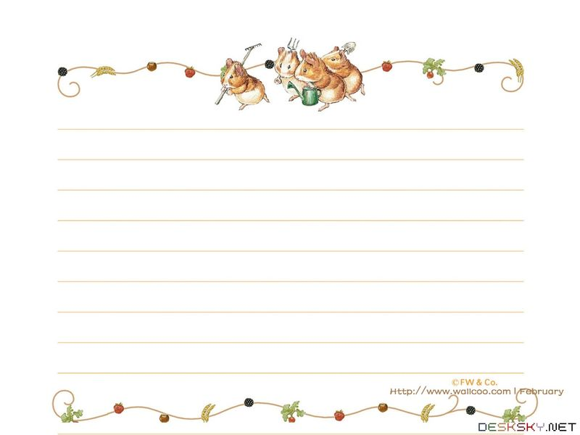
A: Look! This is my….
He/ She is handsome/ beautiful….
B: Who’s he/she?
A: He/ She is my….
B: What’s your mother’s/ father’s job?
A: He/ She is a /an….

Slide 3
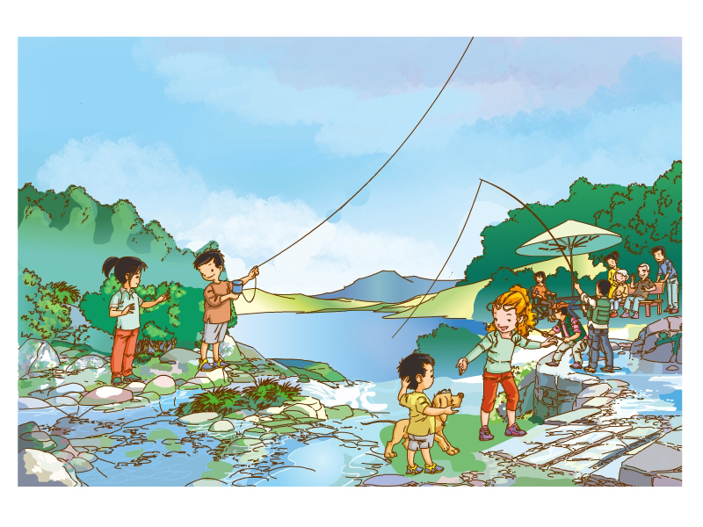

Slide 4

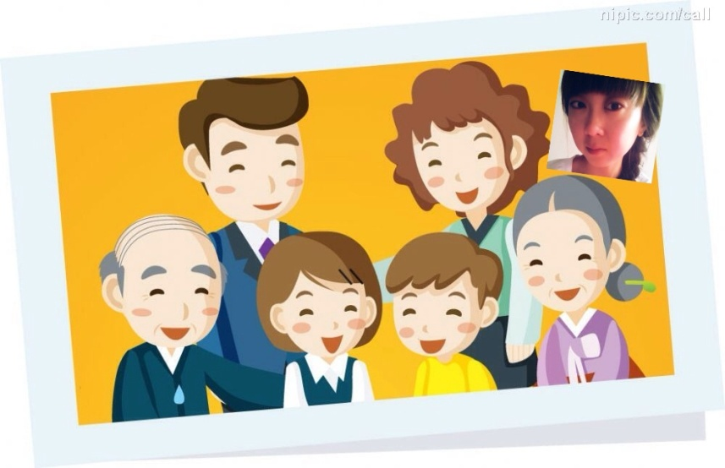
A: Is she/ he your…?
B: Yes, she/he is./ No, she/he isn’t.
She/ he is handsome/ beautiful/
tall/thin….

Slide 5
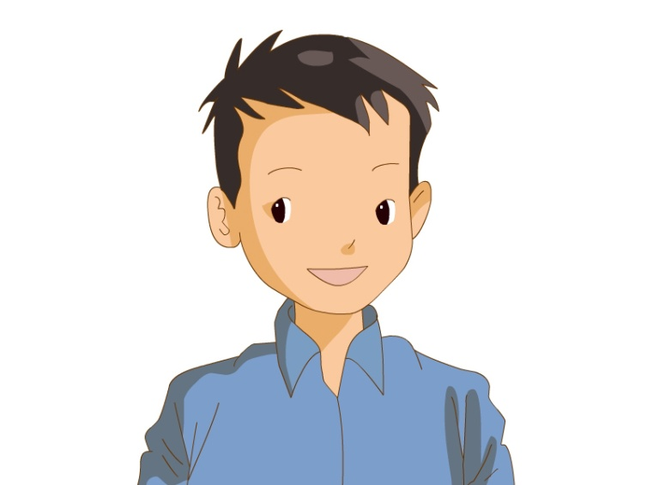
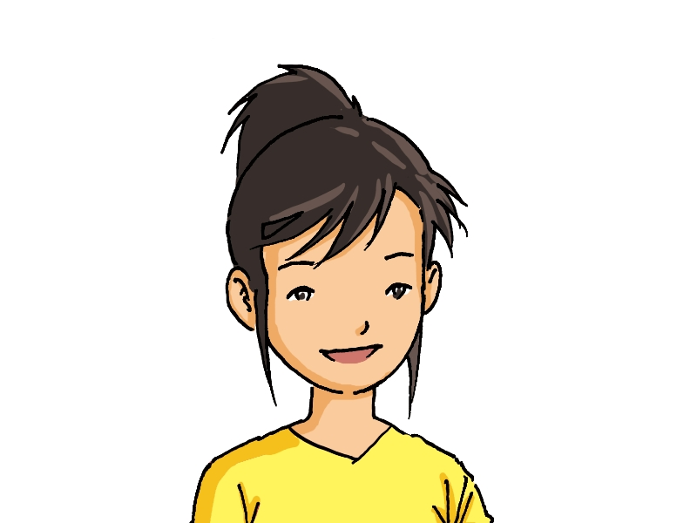
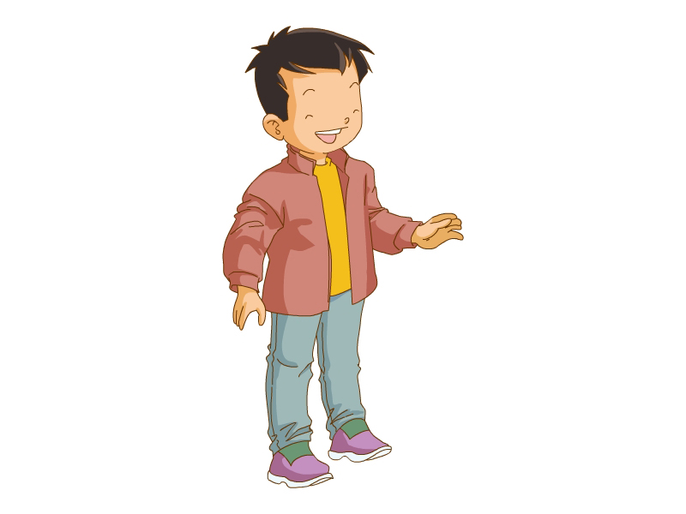
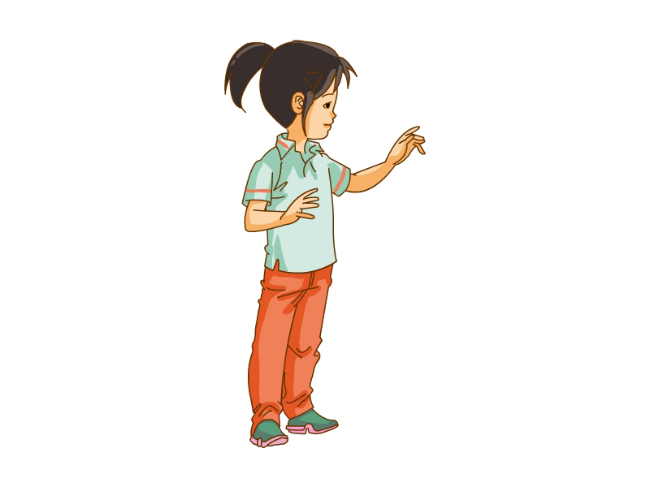
Is that man your father?
Is that woman your mother?
Is that boy your brother?
Is that girl your sister?

Slide 6
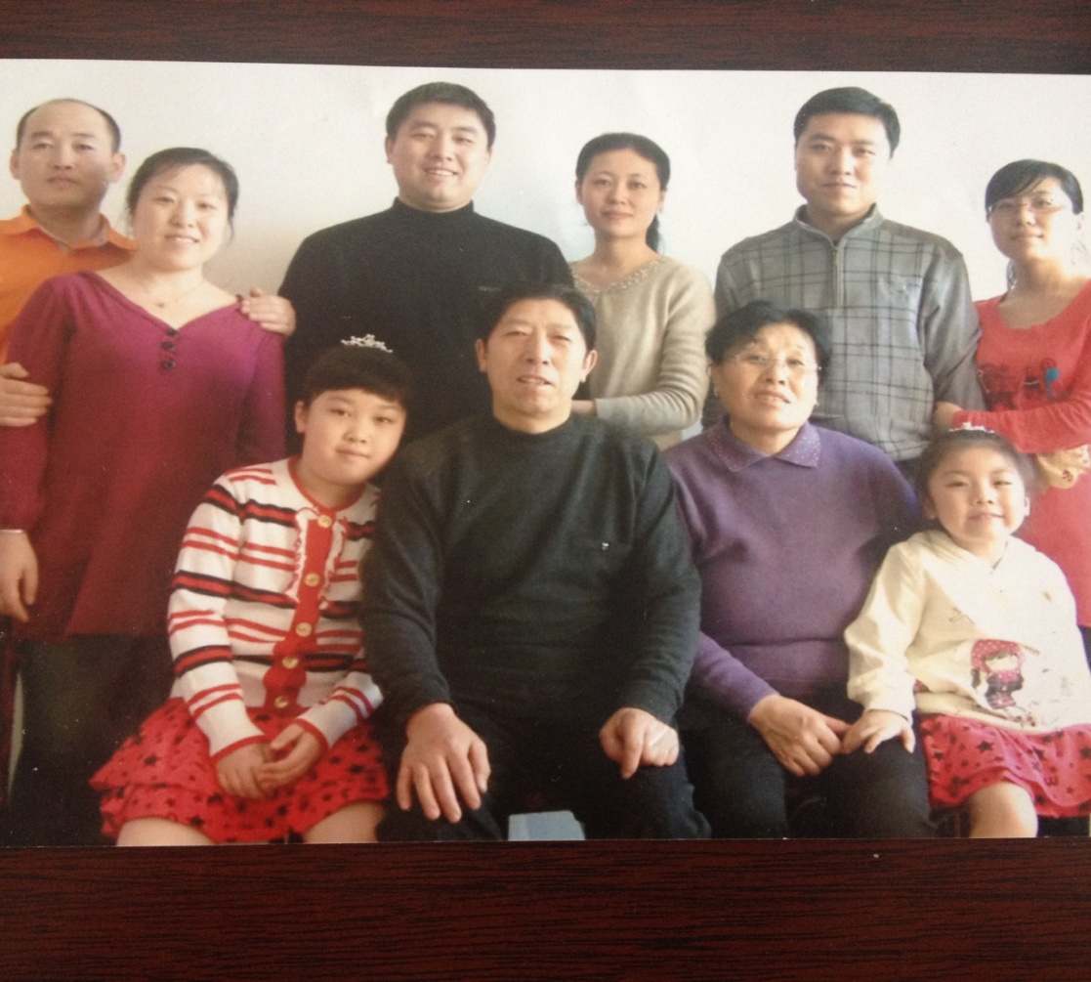
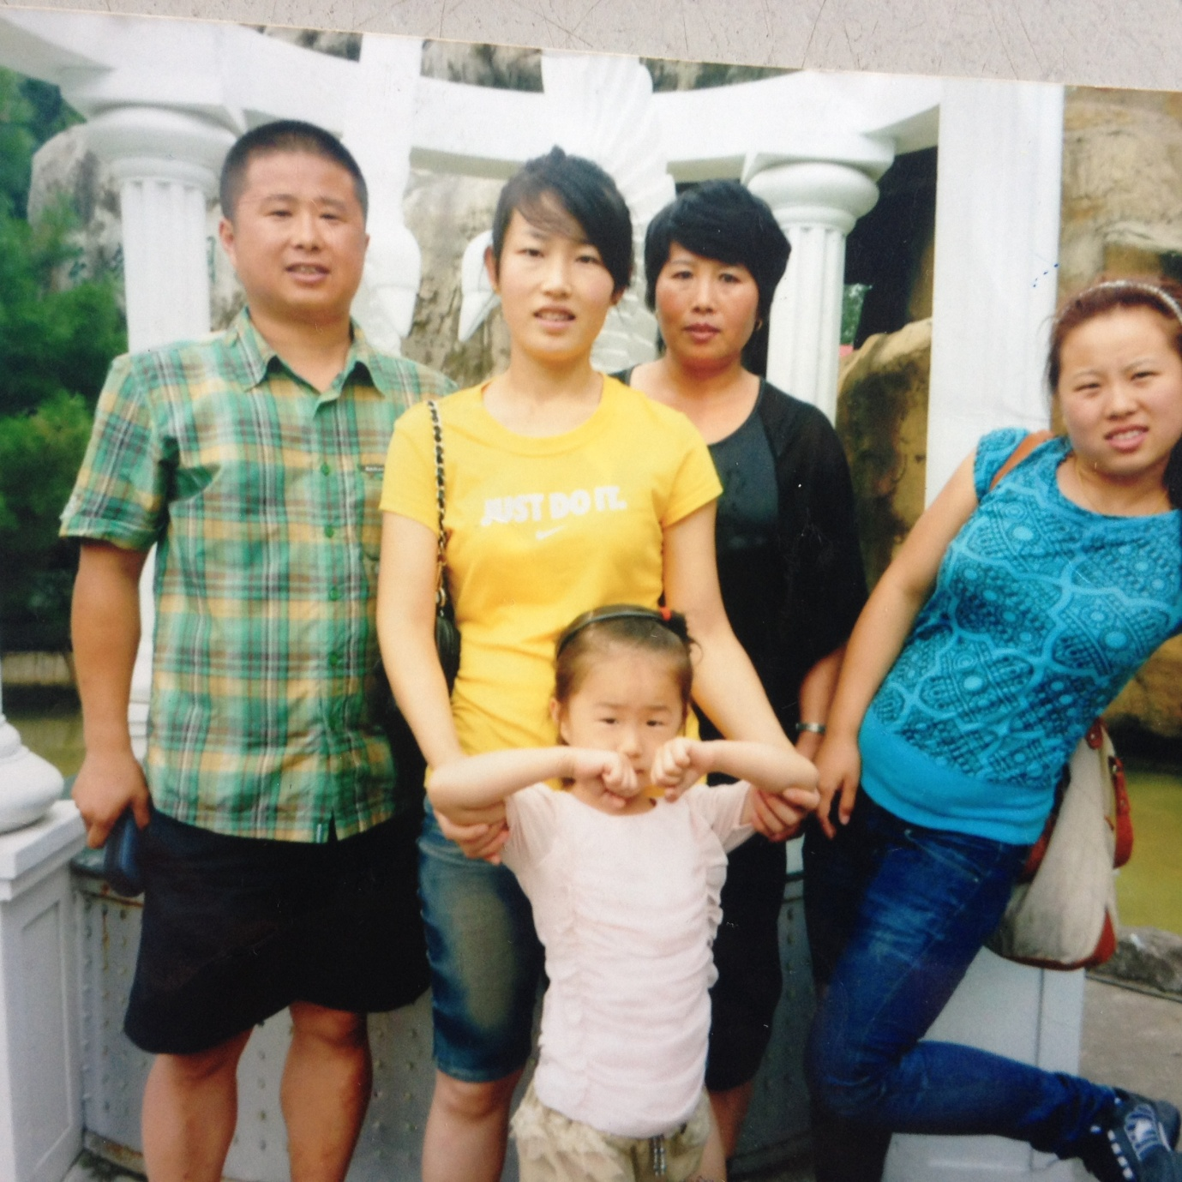
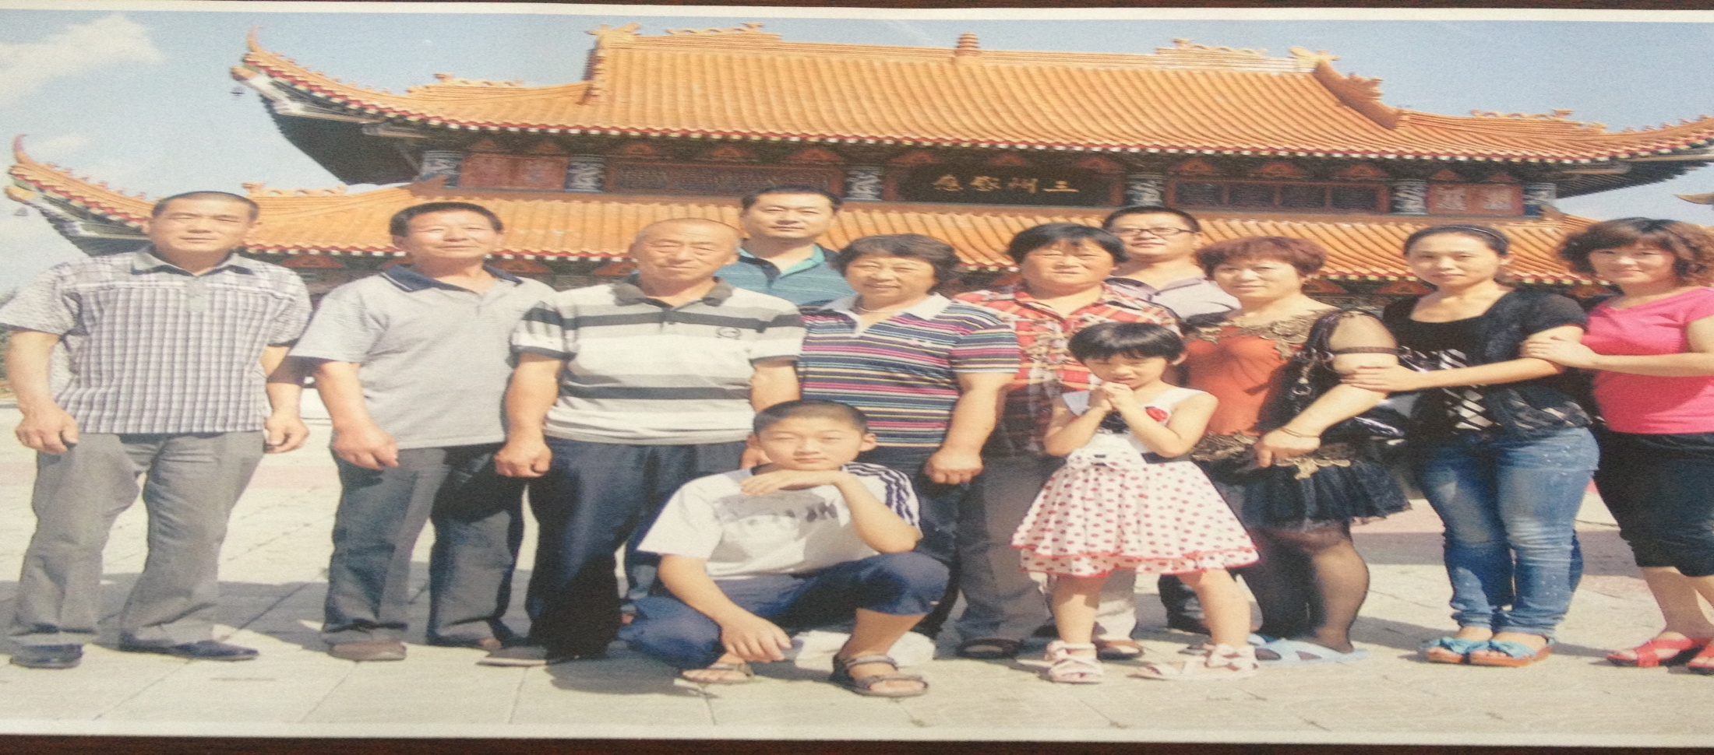

Slide 7

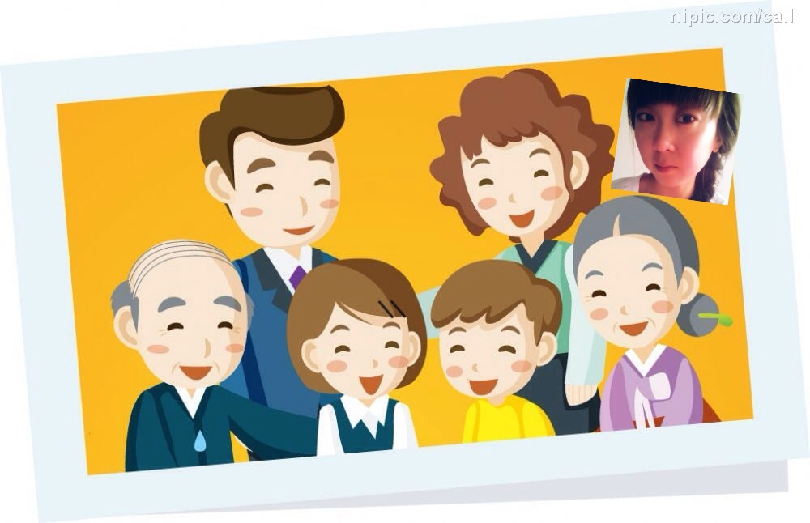
A: Who’s he/she?
B: He/ She is my….
A: Is that/this man/ woman/ boy
/ girl your…?
B: Yes, she/he is./
No, she/he isn’t.

Slide 8

Is she your mom? Yes, yes, yes.
Is he your dad? No, no, no.
Is she your grandma? Yes, yes, yes.
Is he your grandpa? No, no, no
Is she your aunt? Yes, yes, yes.
Is he your uncle? No, no, no
Is he your cousin? Yes, yes, yes.

Slide 9


Slide 10
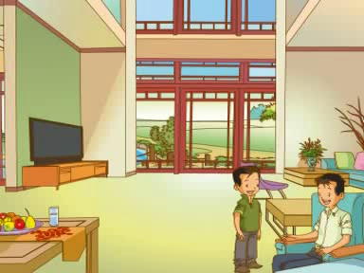

Slide 11

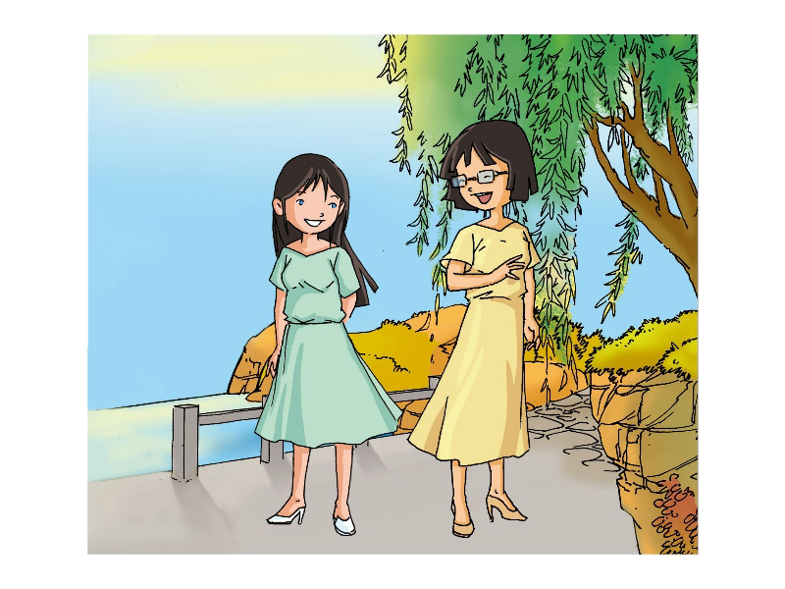
My name is Mary. My mother is 35years old. She has short hair. She is tall and beautiful. She is wearing a yellow dress and a pair of yellow shoes.
My aunt is 32 years old.
She is short and she is pretty.
She has big blue eyes.
She is wearing a beautiful
green dress.

Slide 12

A: Who’s he/she?
B: He/ She is my….
A: What does she/he look like?
B: He/ She is….
A: Is she/ he/this/ that your…?
B: Yes, she/he is./ No, she/he isn’t.
A: What’s your…’s job?
(What’s your…?= What does your… do?)
B: He/ She is a/ an teacher/
enginner/cook/nurse…

Slide 13

Homework:
Practice the dialogue with your parents.

